Slide 1
Monetary Aggregates Analysis
Evaggelos Grammenidis

Slide 2
Introduction
In this presentation we conduct an analysis of monetary aggregates
Specifically, we focus on:
Analysis of inflation over time
Analysis of inflation in relation to the growth rate of the supply of money
Challenging the Quantity theory of Money
Analysis of inflation in relation to loan percentages

Slide 3
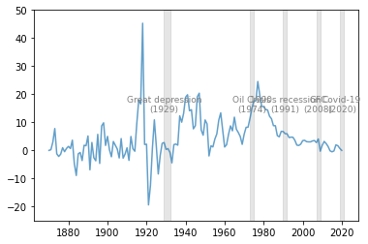
Inflation
We present the evolution of inflation over time
Inflation was more susceptible to negative values before 1950s
We observe a sharp increase in the 1970s due to the oil crisis
After the 1950s inflation has remained positive
Graph 1.1 Long-run time series of inflation

Slide 4
Inflation – Monetary Aggregates
We compare inflation to the growth rate of monetary aggregates using two definitions (M1, M2)
M1 – Narrow money: The sum of currency in circulation and overnight deposits plus short run deposits (<2 years) and deposits redeemable at notice up to three months
M2 – Broad money: M1 plus repurchase agreement (repos), money market funds and debt securities (<2 years)

Slide 5
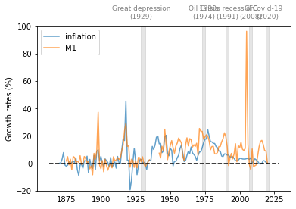
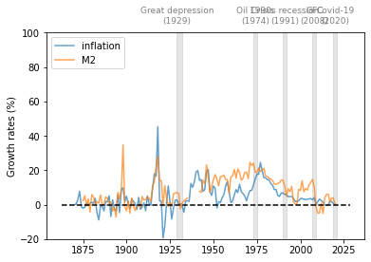
Inflation – Monetary Aggregates
Graph 1.2 Inflation and Money supply growth M1 Graph 1.3 Inflation and Money supply growth M2

Slide 6
Inflation – Monetary Aggregates
We find that the correlation is positive regardless of the definition we use for the supply of money
We note that M1 seems more volatile than M2 during periods of economic crisis
A possible explanation for this is the sudden change of the behavior of consumers and investors when a crisis occurs which negatively affects money in circulation

Slide 7
Quantity Theory of Money
We test for the accuracy of the Quantity Theory of Money MV = PY
M: money supply
V: velocity of money
P: aggregate price level
Y: real output
According to the QTM k = M÷(P×Y) is constant
We test this theory by presenting a scaled-up mapping of the evolution of k over time using M1 and M2

Slide 8
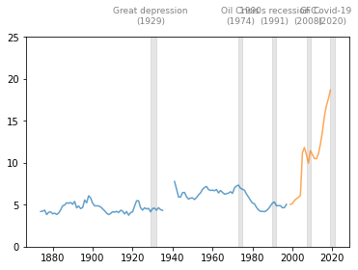
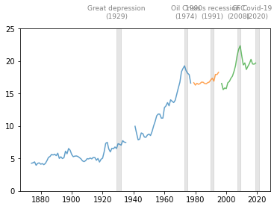
Quantity Theory of Money
Graph 1.4 k over time calculated using M1 Graph 1.5 k over time calculated using M2

Slide 9
Quantity Theory of Money
The Quantity Theory of Money states that k stays constant over time
While this conclusion seems consistent with our analysis, we observe a tendency for k to increase over time
While minor changes over time could be attributed to a standard error, a better explanation for this tendency is that the velocity of money keeps decreasing due to increase in the supply of money since the 1950s
This explanation is consistent with the tendency of inflation to remain positive since that period
By dividing different time periods based on the data sources used by the microhistory database we can rule out problems that can occur due to inconsistent data

Slide 10
Loan Percentages
We calculate total household loans (THH), total business loans (TBUS) and total mortgage loans (TMORT) as a percentage of total loans. We then present these percentages in correlation to inflation. We also present total loans in correlation to inflation

Slide 11
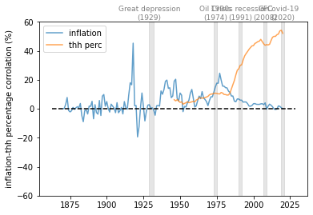
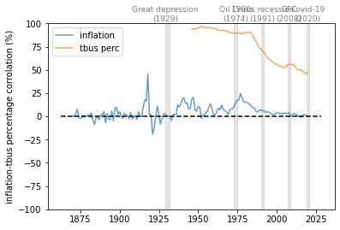
Loan Percentages
Graph 1.6 Total Household Loans percentage and Inflation Graph 1.7 Total Business Loans percentage and Inflation

Slide 12
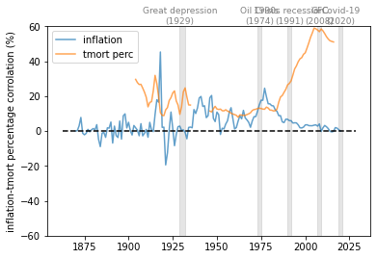
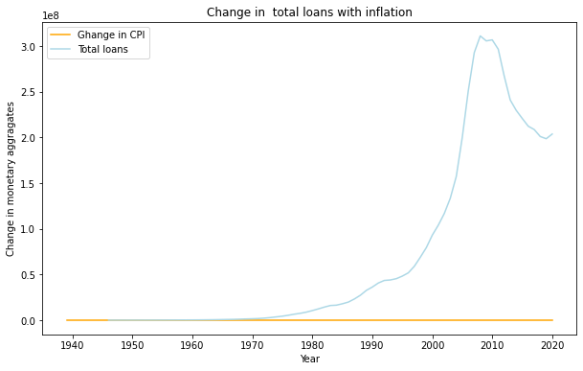
Loan Percentages
Graph 1.8 Total Mortgage Loans percentage and Inflation Graph 1.9 Total Loans and Inflation

Slide 13
Loan Percentages
We find a negative correlation between inflation, total household loans and total mortgage loans
On the other hand, total business loans show a positive correlation to inflation, which is consistent with our previous observation
We can see that the correlation of total loans to inflation is zero

Slide 14
Conclusion - Summary
In this presentation we conducted an analysis of monetary aggregates by focusing on inflation, the growth rate of monetary aggregates, the QTM and the correlation between inflation and loan percentages
We traced inflation and the growth rate of monetary aggregates using definitions M1 and M2 and found that there is a positive correlation between inflation and the supply of money
We tested the QTM and found a tendency for k to increase over time especially when using the M2 definition as a result of changes in monetary policy after the 1950s
Lastly, we presented inflation in correlation to the percentages of various loans to total loans and found a positive correlation between inflation and the percentage of business loans to total loans

Slide 15

Thank you for your attention!
Feel free to ask me questions

